Slide 1

Chapter 22
Network Layer:
Delivery, Forwarding,
and Routing
22.<number>
Copyright © The McGraw-Hill Companies, Inc. Permission required for reproduction or display.

Slide 2
22-1 DELIVERY
The network layer supervises the handling of the packets by the underlying physical networks. We define this handling as the delivery of a packet.
Topics discussed in this section:
Direct Versus Indirect Delivery
22.<number>

Slide 3

Figure 22.1 Direct and indirect delivery
22.<number>

Slide 4
Direct delivery The router is not used to forward the packet because the destination is on the same network (subnet or network segment) as the sending host.
Indirect delivery Packets are sent to an intermediate point for forwarding, usually a router.
22.<number>

Slide 5
22-2 FORWARDING
Forwarding means to place the packet in its route to its destination. Forwarding requires a host or a router to have a routing table. When a host has a packet to send or when a router has received a packet to be forwarded, it looks at this table to find the route to the final destination.
Topics discussed in this section:
Forwarding Techniques
Forwarding Process
Routing Table
22.<number>

Slide 6

Figure 22.2 Route method versus next-hop method
22.<number>

Slide 7

Figure 22.3 Host-specific versus network-specific method
22.<number>

Slide 8

Figure 22.4 Default method
A default router will be used if a known route does not exist for a given destination address.
22.<number>

Slide 9
Subnet Mask
A subnet mask is used to divide an IP address into two parts. One part identifies the host (computer), the other part identifies the network to which it belongs.
A Netmask is a 32-bit "mask" used to divide an IP address into subnets and specify the network's available hosts. In a netmask, two bits are always automatically assigned. For example, in 255.255. 225.0, "0" is the assigned network address.
To better understand how IP addresses and subnet masks work, visit:
https://learn.microsoft.com/en-us/troubleshoot/windows-client/networking/tcpip-addressing-and-subnetting
22.<number>

Slide 10

Figure 22.5 Simplified forwarding module in classless address
22.<number>

Slide 11

Note
In classless addressing, we need at least four columns in a routing table.
22.<number>

Slide 12
Example 22.1
Make a routing table for router R1, using the configuration in Figure 22.6.
Solution
Table 22.1 shows the corresponding table.
22.<number>

Slide 13

Figure 22.6 Configuration for Example 22.1
22.<number>

Slide 14

Table 22.1 Routing table for router R1 in Figure 22.6
22.<number>

Slide 15
22-3 UNICAST ROUTING PROTOCOLS
A routing table can be either static or dynamic. A static table is one with manual entries. A dynamic table is one that is updated automatically when there is a change somewhere in the Internet. A routing protocol is a combination of rules and procedures that lets routers in the Internet inform each other of changes.
Topics discussed in this section:
Optimization
Intra- and Interdomain Routing
Distance Vector Routing and RIP
Link State Routing and OSPF
Path Vector Routing and BGP
22.<number>

Slide 16

Figure 22.13 Popular routing protocols
22.<number>

Slide 17

Figure 22.14 Distance vector routing tables
22.<number>

Slide 18

Figure 22.15 Initialization of tables in distance vector routing
22.<number>

Slide 19
Note
In distance vector routing, each node shares its routing table with its
immediate neighbors periodically and when there is a change.
22.<number>

Slide 20

Figure 22.16 Updating in distance vector routing
22.<number>

Slide 21

Figure 22.20 Concept of link state routing
22.<number>

Slide 22

Figure 22.21 Link state knowledge
22.<number>

Slide 23

Figure 22.22 Dijkstra algorithm
22.<number>

Slide 24

Figure 22.23 Example of formation of shortest path tree
22.<number>

Slide 25

Table 22.2 Routing table for node A
22.<number>

Slide 26

Figure 22.24 Areas in an autonomous system
22.<number>

Slide 27
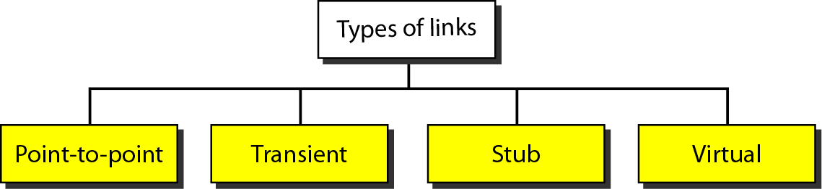
Figure 22.25 Types of links
22.<number>

Slide 28
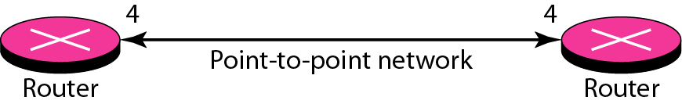
Figure 22.26 Point-to-point link
22.<number>

Slide 29
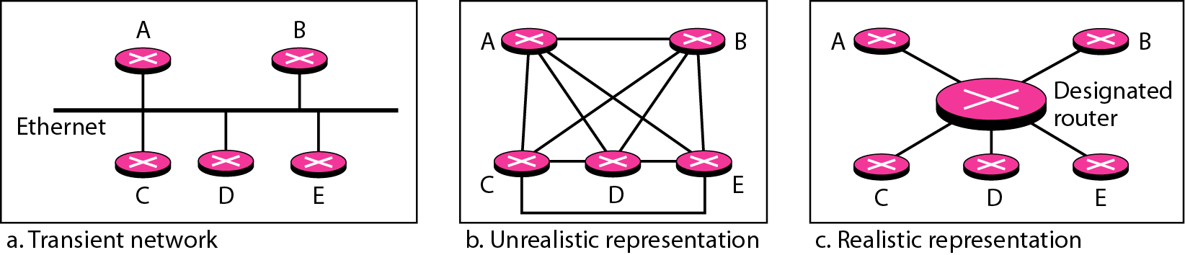
Figure 22.27 Transient link
22.<number>

Slide 30
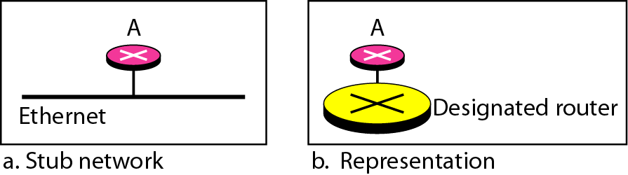
Figure 22.28 Stub link
22.<number>

Slide 31
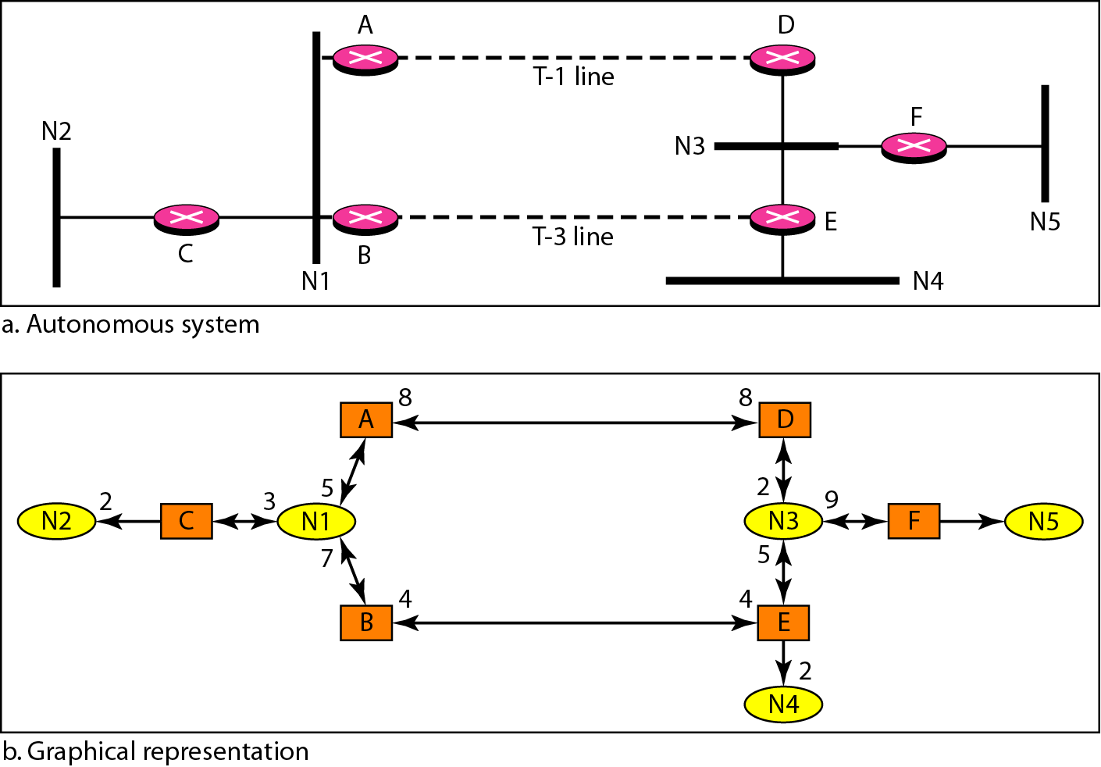
Figure 22.29 Example of an AS and its graphical representation in OSPF
22.<number>

Slide 32
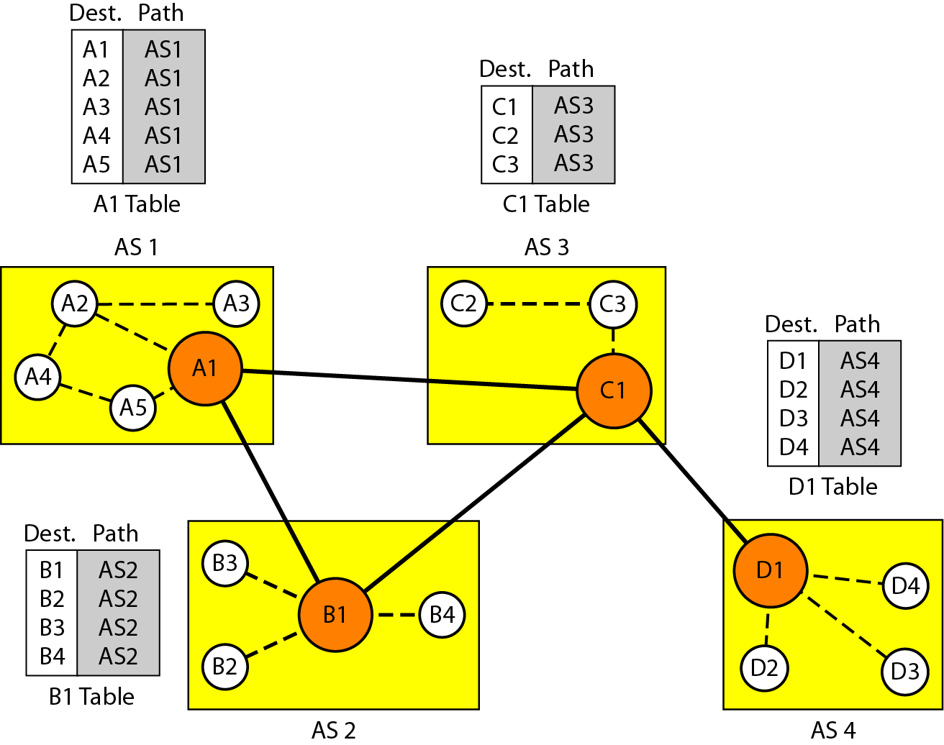
Figure 22.30 Initial routing tables in path vector routing
22.<number>

Slide 33
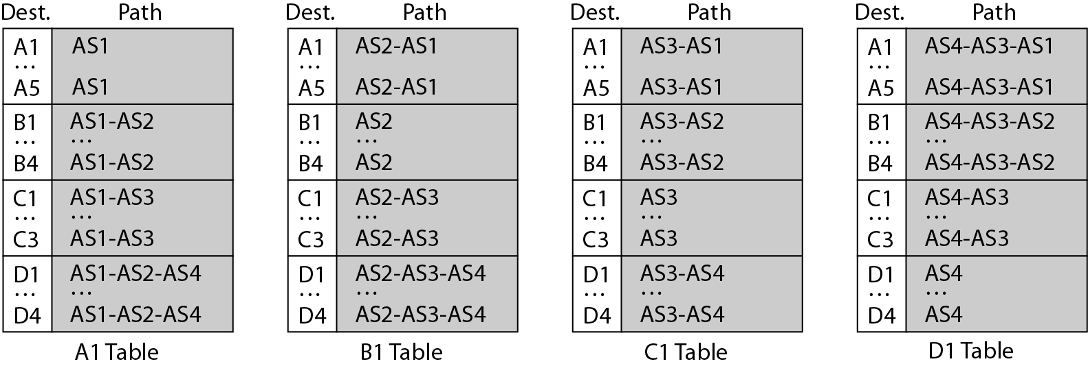
Figure 22.31 Stabilized tables for three autonomous systems
22.<number>

Slide 34
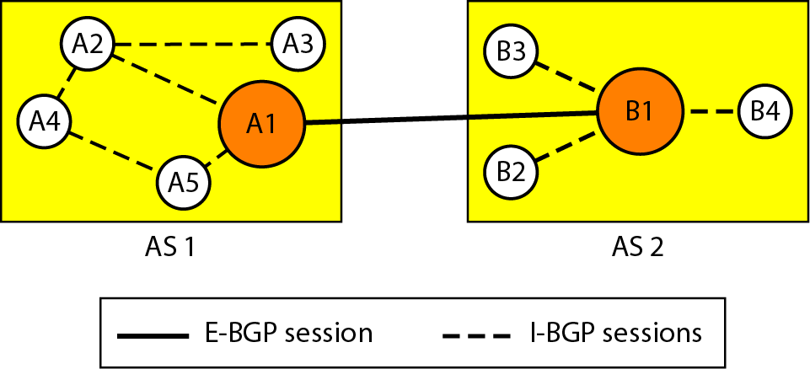
Figure 22.32 Internal and external BGP sessions
22.<number>

Slide 35
22-4 MULTICAST ROUTING PROTOCOLS
In this section, we discuss multicasting and multicast routing protocols.
Topics discussed in this section:
Unicast, Multicast, and Broadcast
Applications
Multicast Routing
Routing Protocols
22.<number>

Slide 36
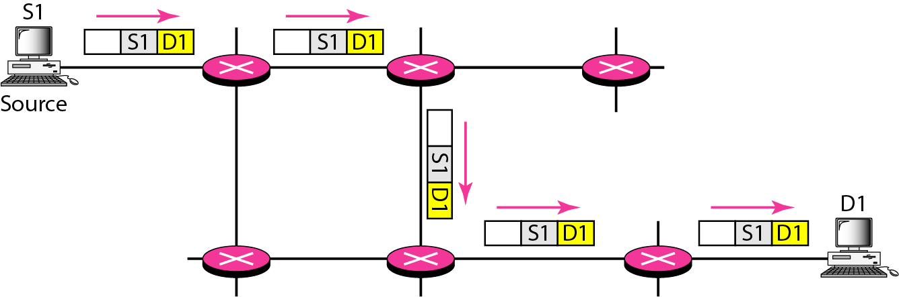
Figure 22.33 Unicasting
22.<number>

Slide 37
Note
In unicasting, the router forwards the received packet through
only one of its interfaces.
22.<number>

Slide 38
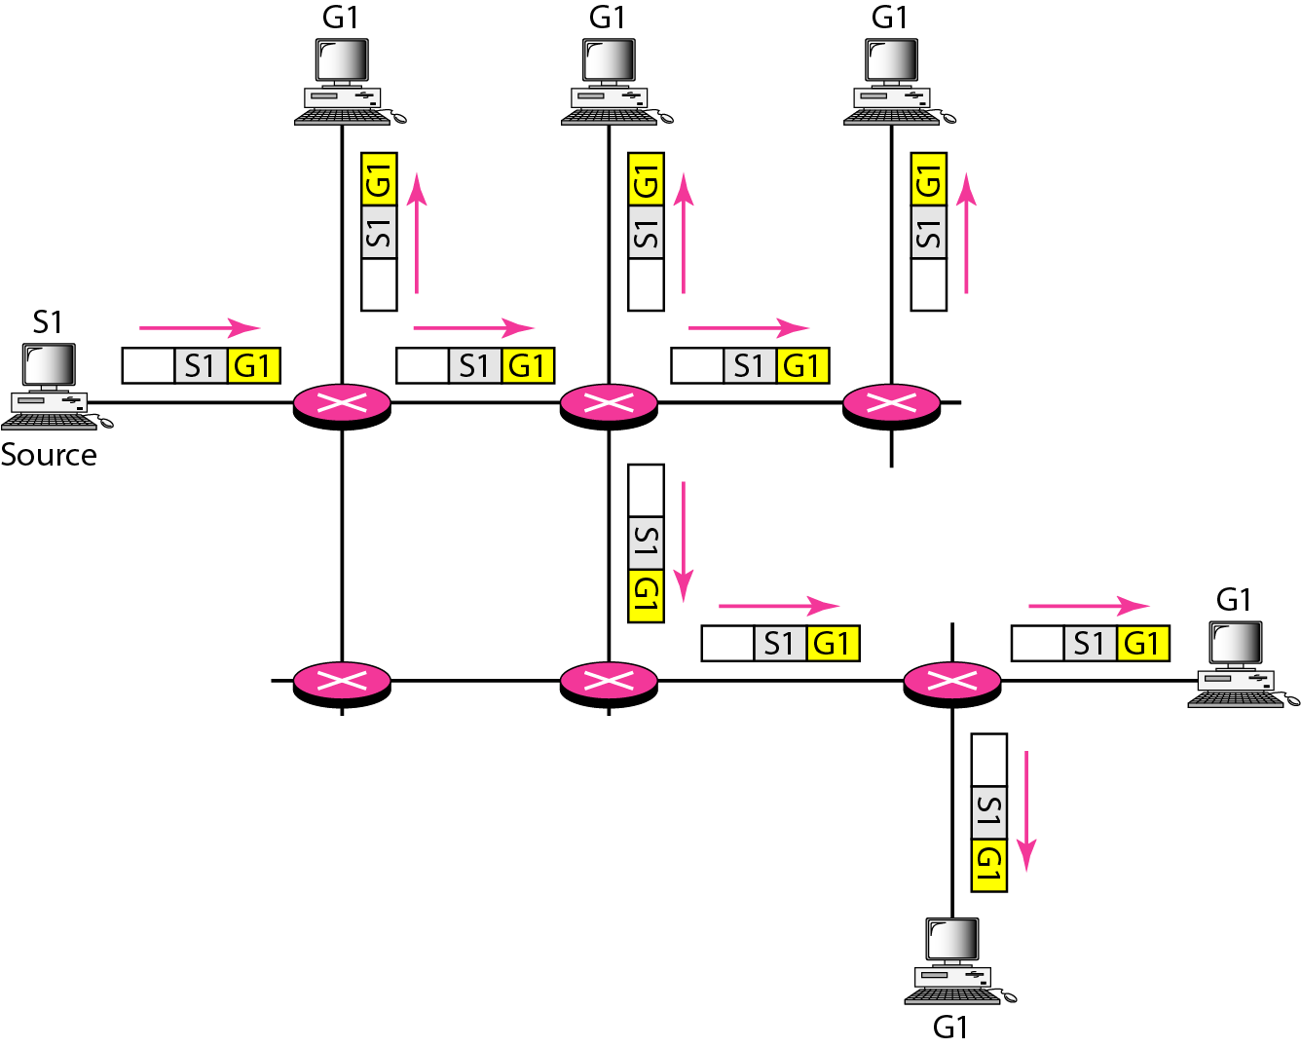
Figure 22.34 Multicasting
22.<number>

Slide 39
Note
In multicasting, the router may
forward the received packet
through several of its interfaces.
22.<number>

Slide 40
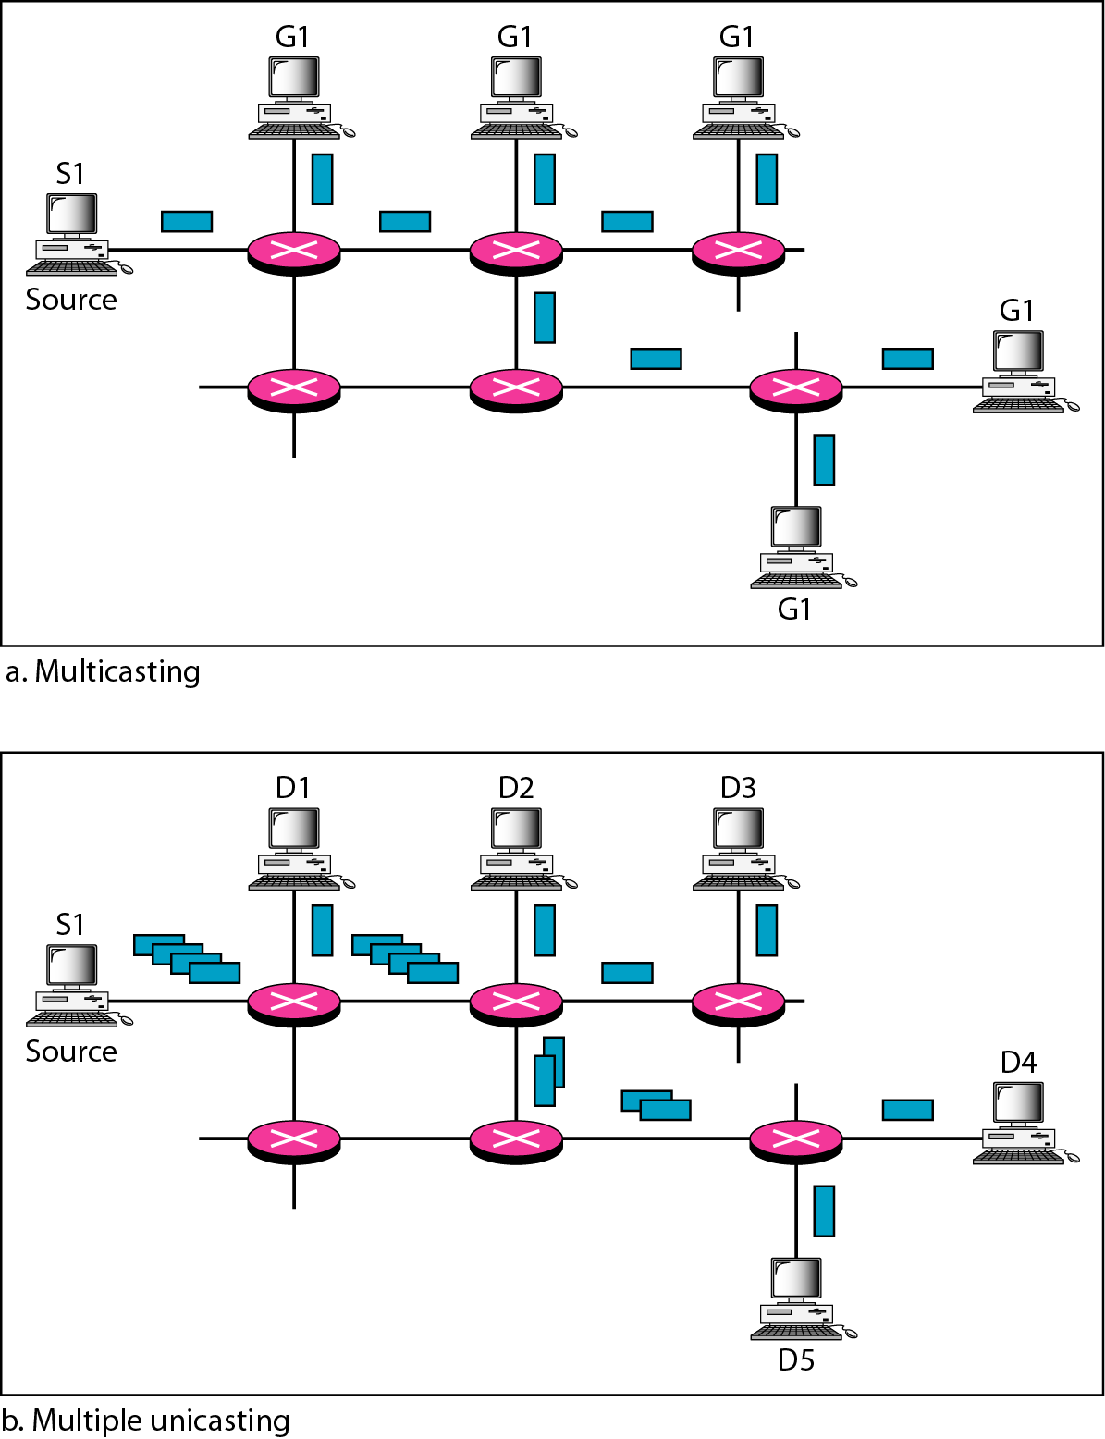
Figure 22.35 Multicasting versus multiple unicasting
22.<number>

Slide 41
Note
Emulation of multicasting through multiple unicasting is not efficient
and may create long delays,
particularly with a large group.
22.<number>

Slide 42
Note
In unicast routing, each router in the domain has a table that defines
a shortest path tree to possible destinations.
22.<number>

Slide 43
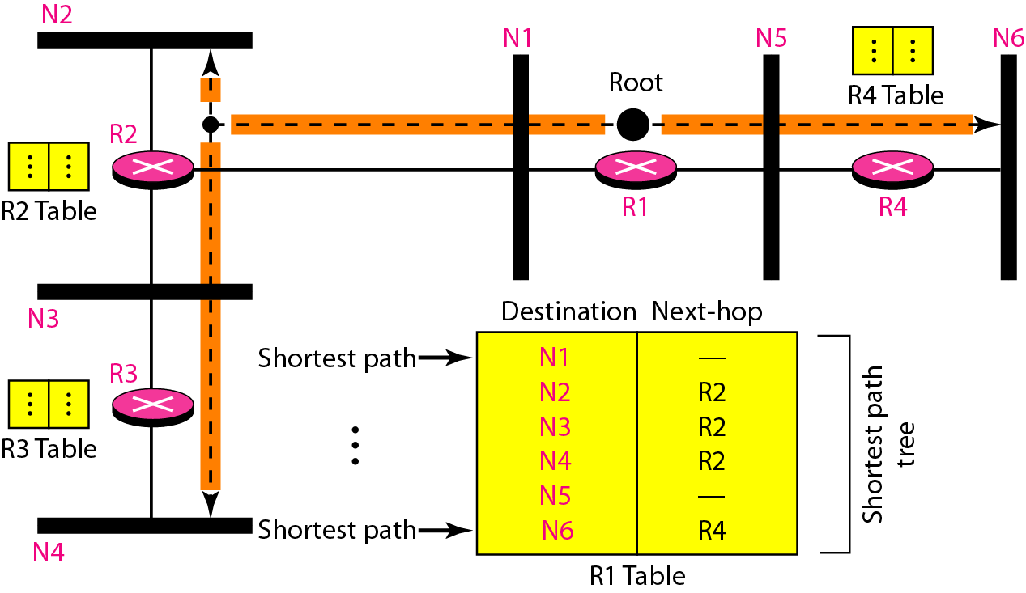
Figure 22.36 Shortest path tree in unicast routing
22.<number>

Slide 44
Note
In multicast routing, each involved router needs to construct
a shortest path tree for each group.
22.<number>

Slide 45
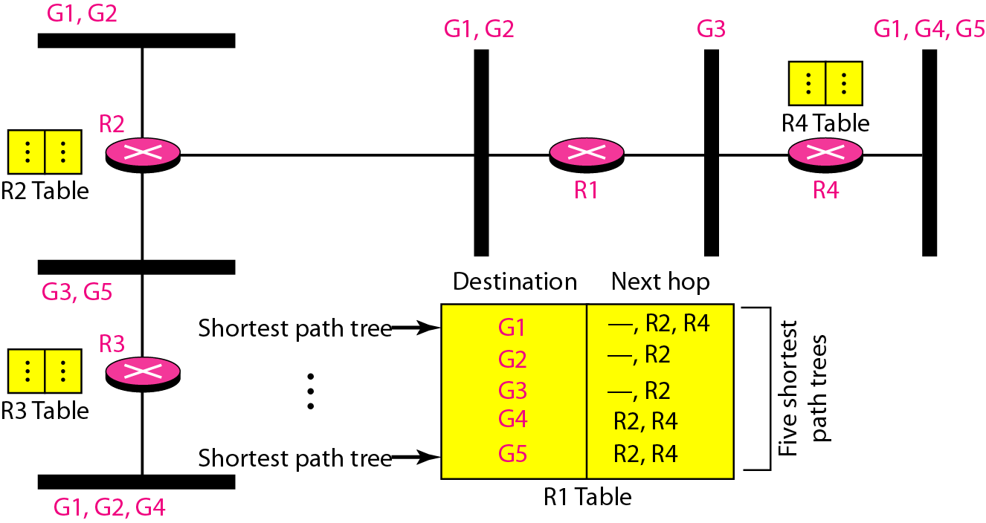
Figure 22.37 Source-based tree approach
22.<number>

Slide 46
Note
In the source-based tree approach, each router needs to have one shortest path tree for each group.
22.<number>

Slide 47
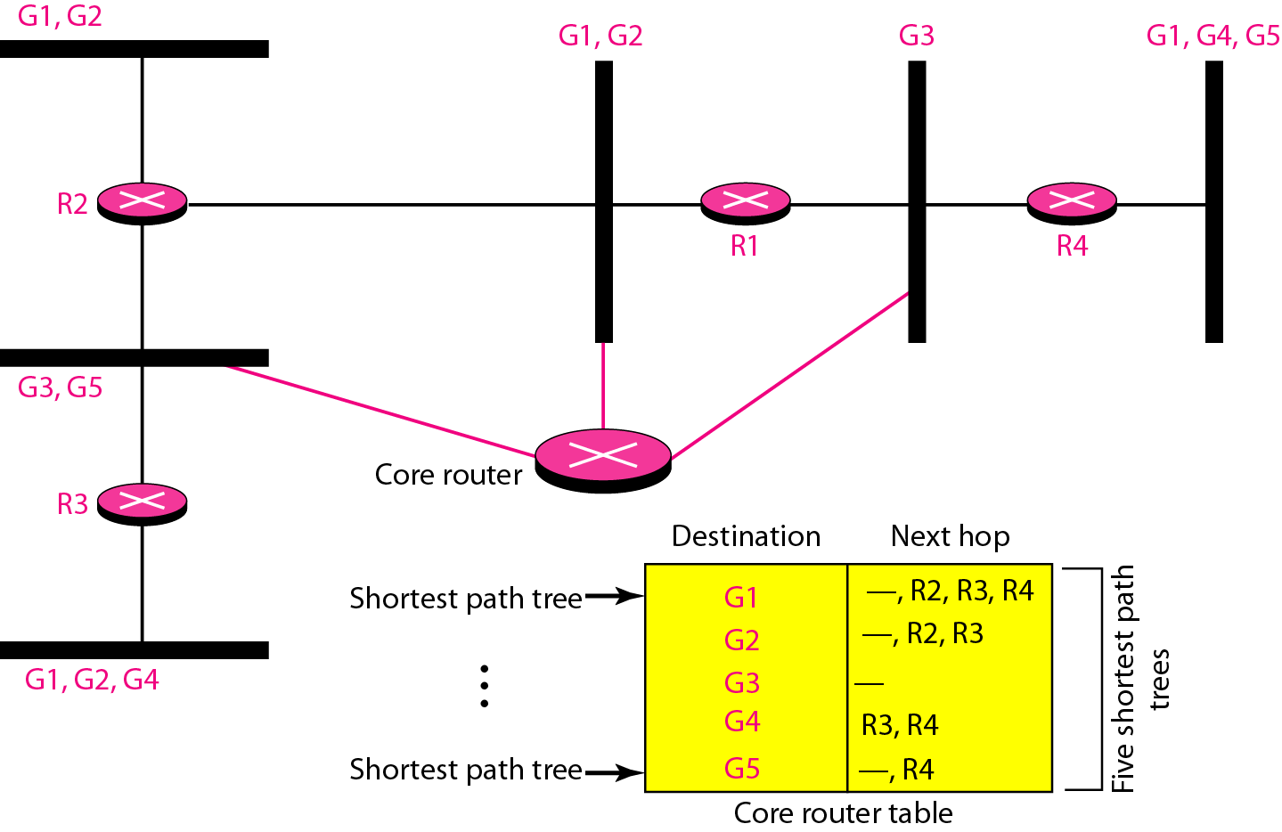
Figure 22.38 Group-shared tree approach
22.<number>

Slide 48
Note
In the group-shared tree approach, only the core router, which has a shortest path tree for each group, is involved in multicasting.
22.<number>

Slide 49
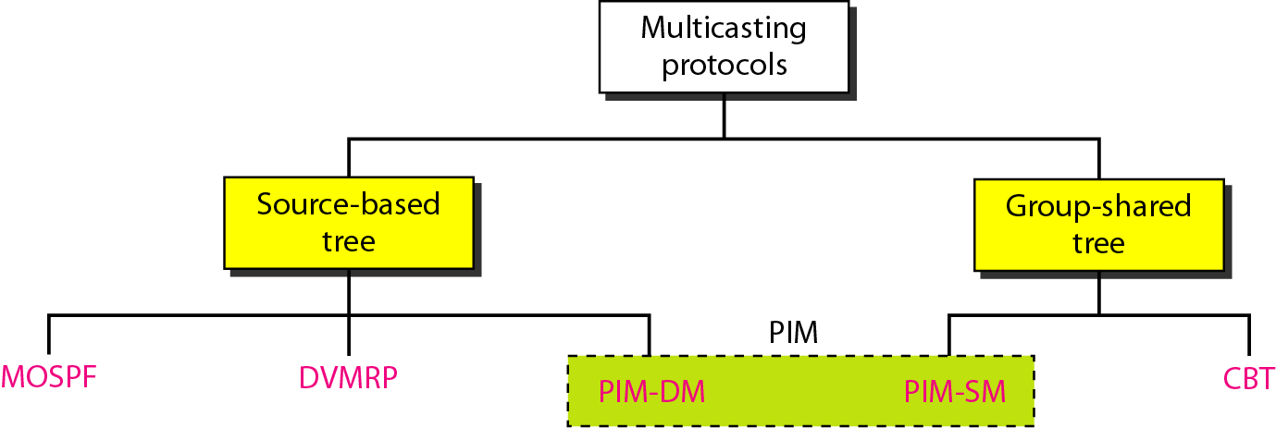
Figure 22.39 Taxonomy of common multicast protocols
22.<number>

Slide 50
Note
Multicast link state routing uses the source-based tree approach.
22.<number>

Slide 51
Note
Flooding broadcasts packets, but creates loops in the systems.
22.<number>

Slide 52
Note
RPF eliminates the loop in the
flooding process.
22.<number>

Slide 53
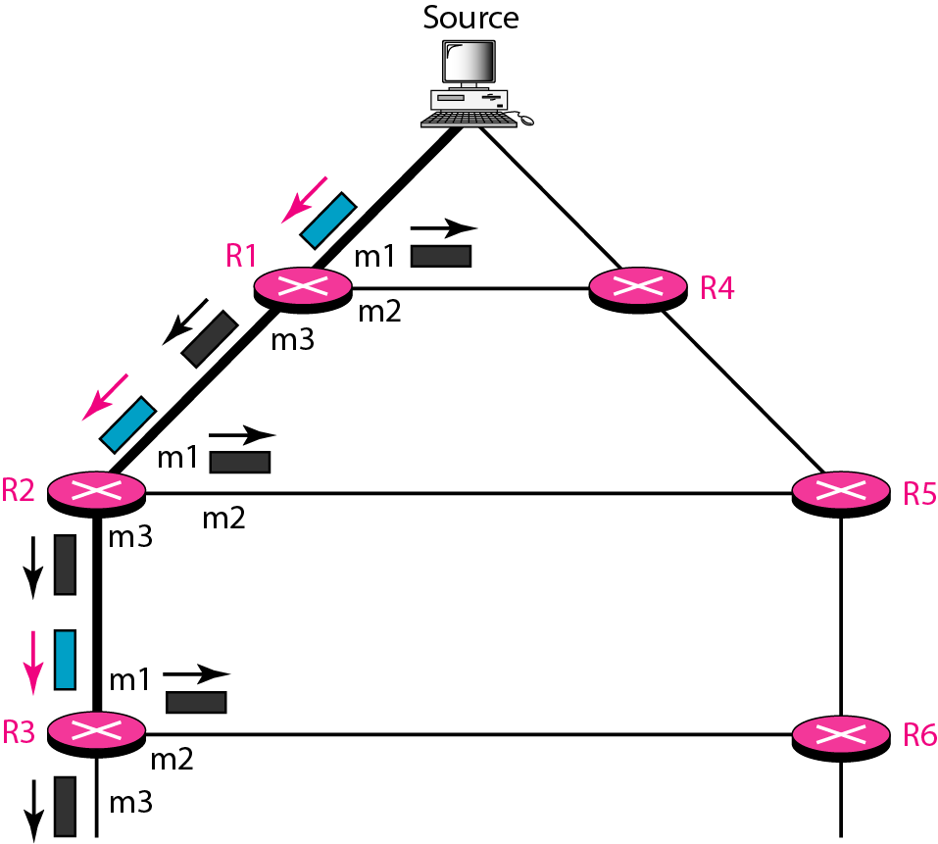
Figure 22.40 Reverse path forwarding (RPF)
22.<number>

Slide 54
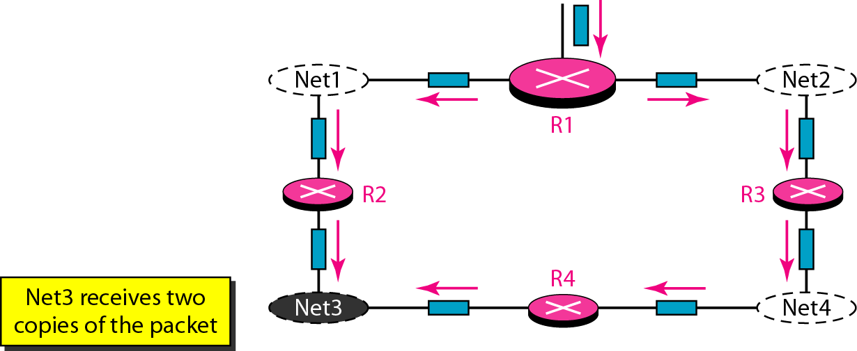
Figure 22.41 Problem with RPF
22.<number>

Slide 55
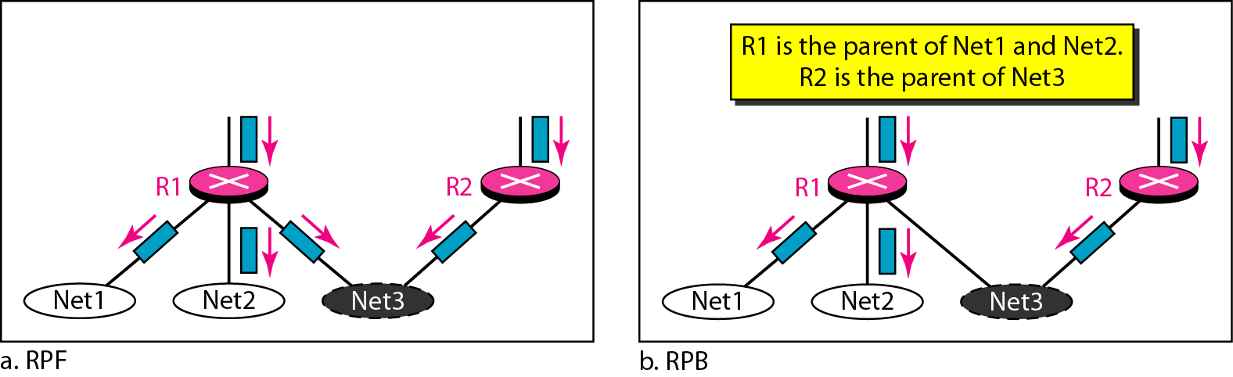
Figure 22.42 RPF Versus RPB
22.<number>

Slide 56
Note
RPB creates a shortest path broadcast tree from the source to each destination.
It guarantees that each destination receives one and only one copy
of the packet.
22.<number>

Slide 57
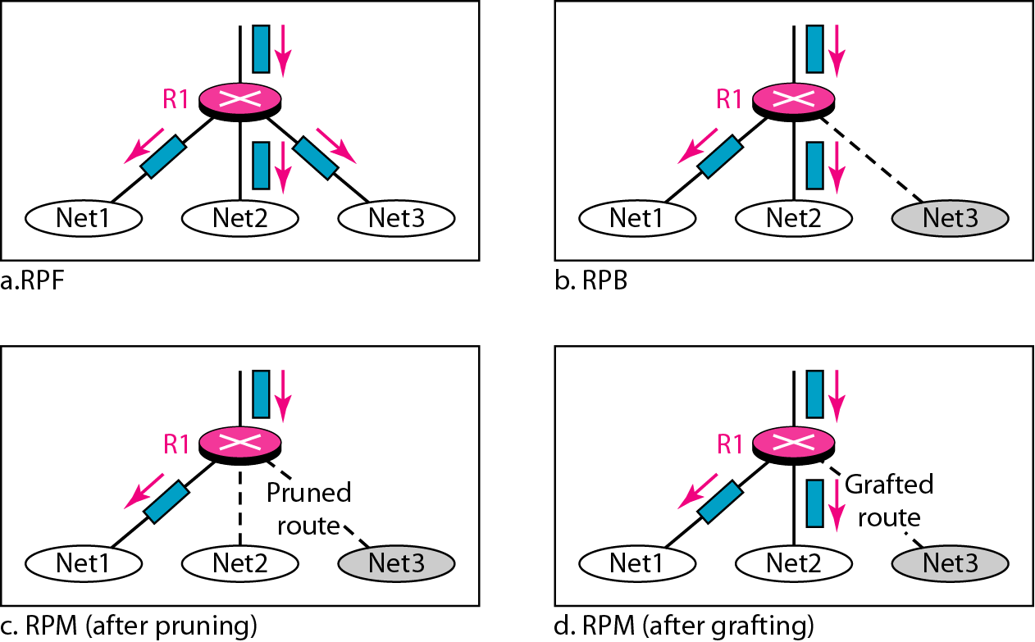
Figure 22.43 RPF, RPB, and RPM
22.<number>

Slide 58
Note
RPM adds pruning and grafting to RPB to create a multicast shortest
path tree that supports dynamic membership changes.
22.<number>

Slide 59
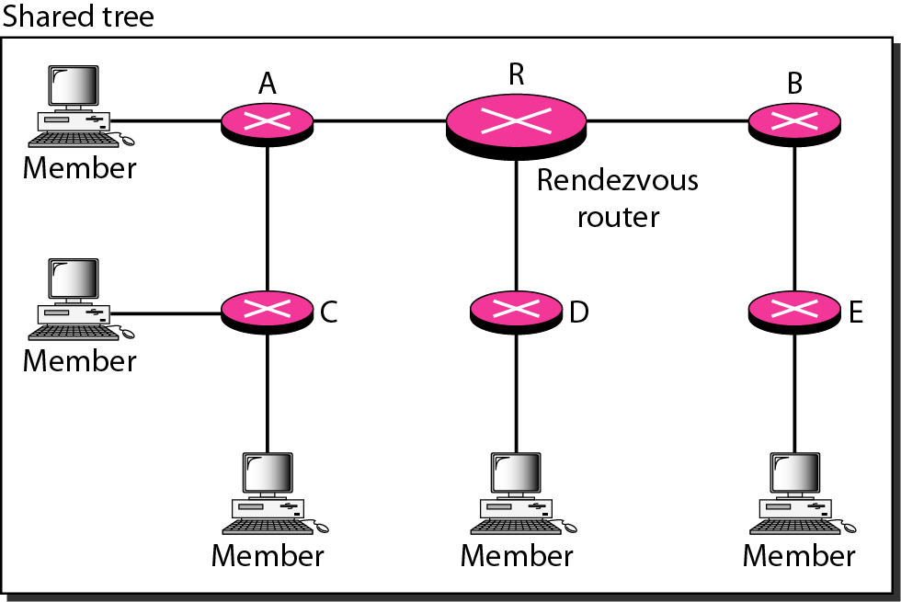
Figure 22.44 Group-shared tree with rendezvous router
22.<number>

Slide 60
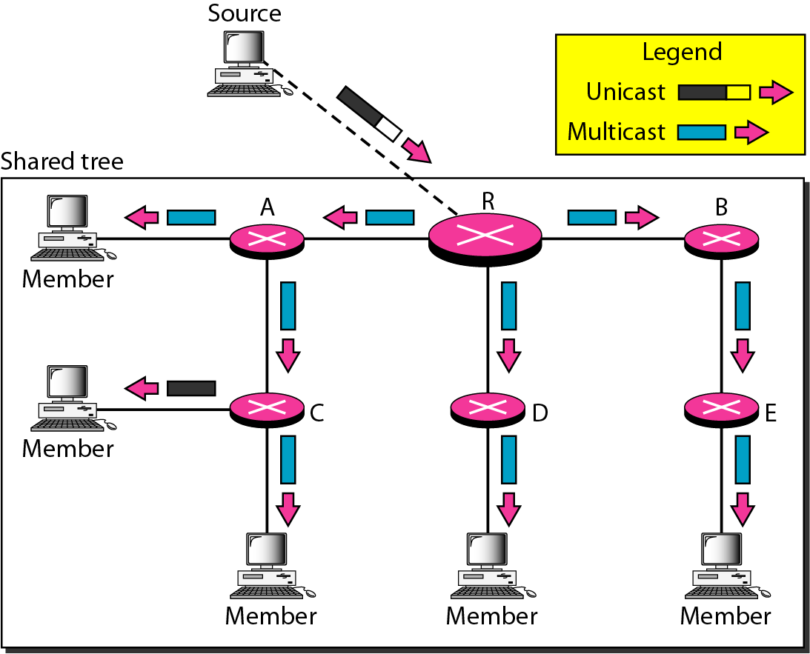
Figure 22.45 Sending a multicast packet to the rendezvous router
22.<number>

Slide 61
Note
In CBT, the source sends the multicast packet (encapsulated in a unicast packet) to the core router. The core router decapsulates the packet and forwards it to all interested interfaces.
22.<number>

Slide 62
Note
PIM-DM is used in a dense multicast environment, such as a LAN.
22.<number>

Slide 63
Note
PIM-DM uses RPF and pruning and grafting strategies to handle multicasting.
However, it is independent of the underlying unicast protocol.
22.<number>

Slide 64
Note
PIM-SM is used in a sparse multicast environment such as a WAN.
22.<number>

Slide 65
Note
PIM-SM is similar to CBT but uses a simpler procedure.
22.<number>

Slide 66
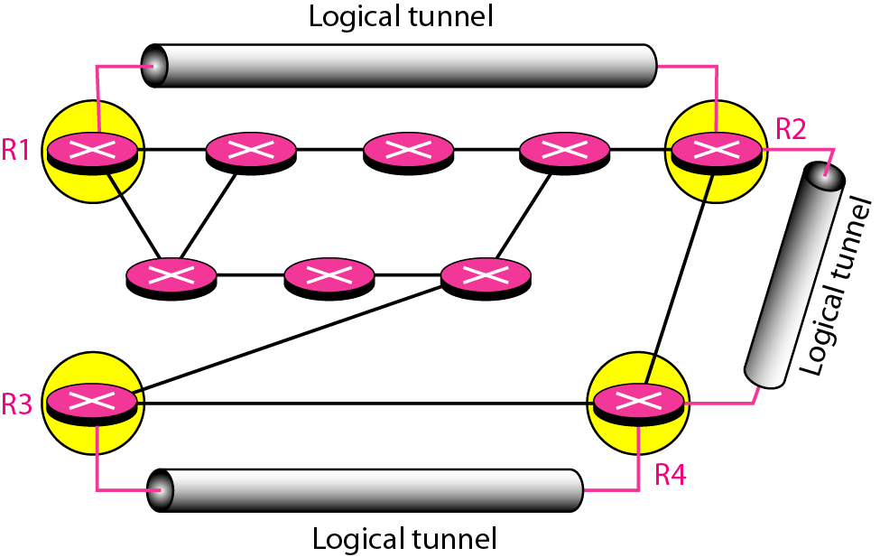
Figure 22.46 Logical tunneling
22.<number>

Slide 67
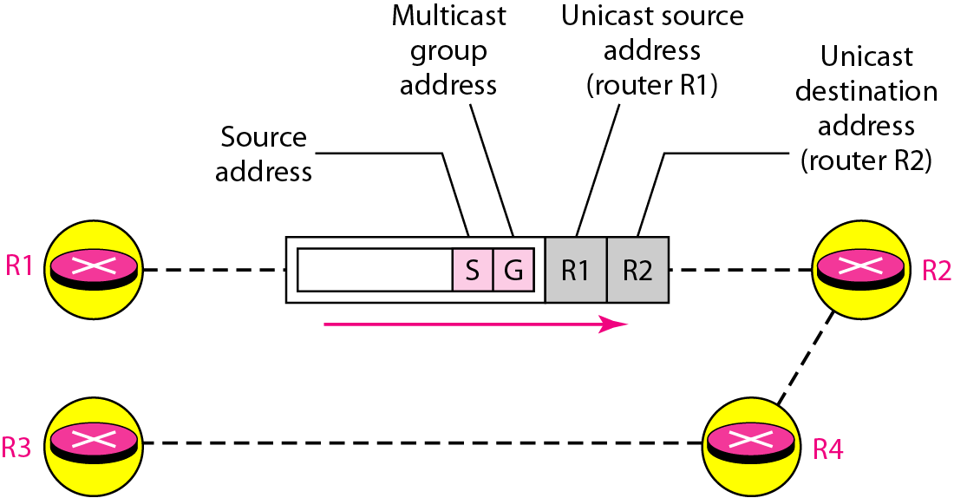
Figure 22.47 MBONE
22.<number>

